Slide 1


Introduction to Reinforcement Learning
Ankush Tale
MS CS - ASU, Ex-Barclays
Amey Athale
MS CS - ASU,
Research@Impact Labs
Notes:
Format: Introduce a problem, and a solution
Disclaimer, Survey: RL is a new concept, basics and heard from news, know about algorithms, worked with algorithms, Know what AGI is?

Slide 2

What is Reinforcement Learning?

Slide 3
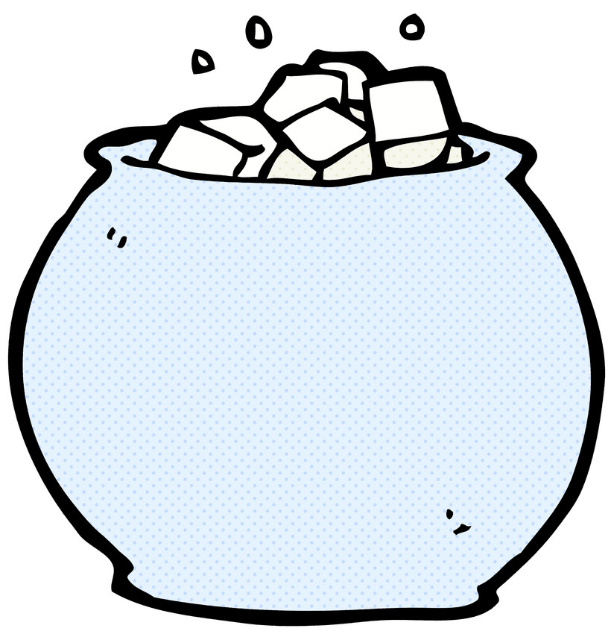

What is Reinforcement Learning?

Slide 4
What is Reinforcement Learning?

Slide 5
What is Reinforcement Learning?

Slide 6
What is Reinforcement Learning?

Slide 7
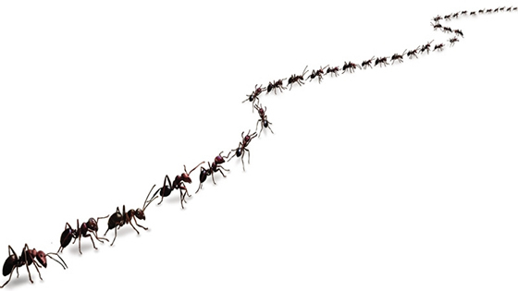
What is Reinforcement Learning?

Slide 8
What is Reinforcement Learning?

Slide 9
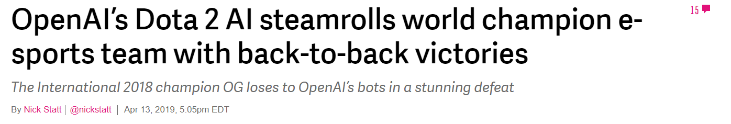
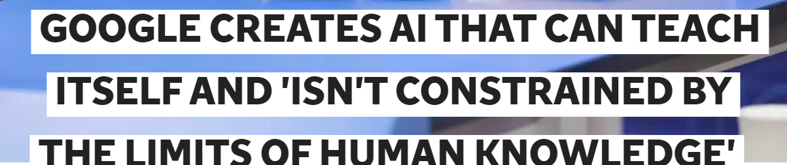
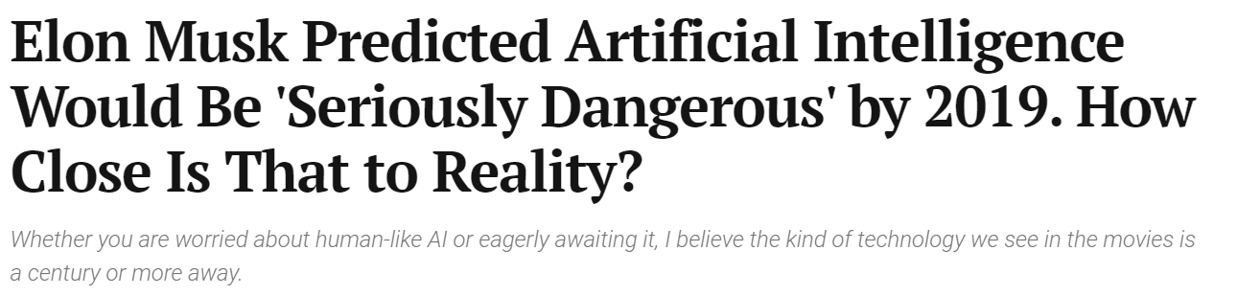
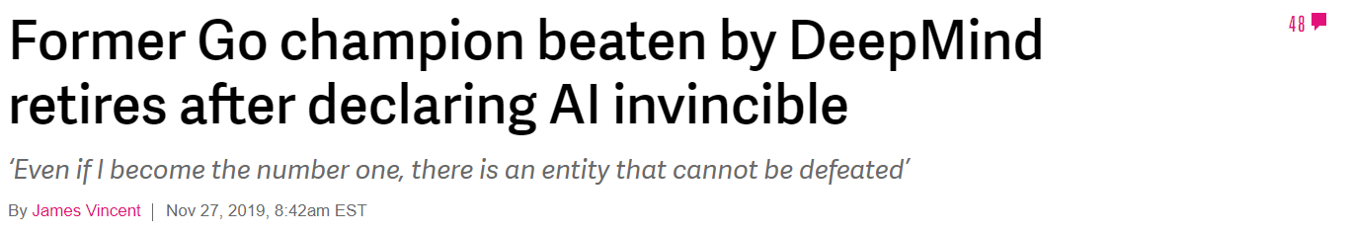
What is Reinforcement Learning?
Goal based learning from an environment
Notes:
In ML, only heard of Supervised and Unsupervised. This is bcz companies prefer task-oriented Supervised (recognition, conversation and predictive analyis) and data-oriented unsupervised (patterns, anomaly discovery) RL is goal-driven and is left for autonomous cars. But despite RL’s lower enterprise profile, it has a high profile in news and media. Hysteria about Artificial General Intelligence and Skynet.

Slide 10
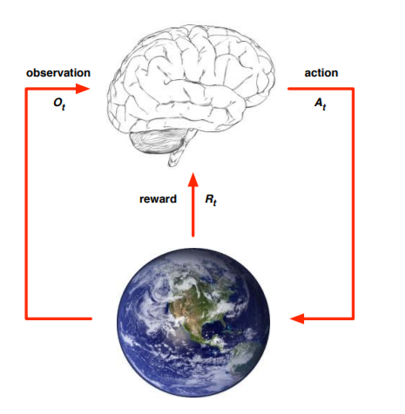
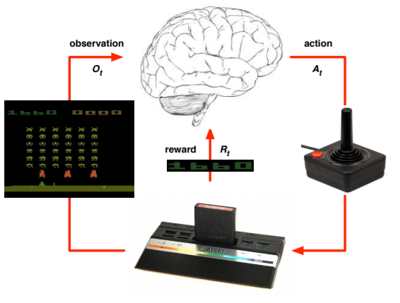
What is Reinforcement Learning?
Characteristics:
There’s no supervisor, only a reward signal
Feedback is delayed, not instantaneous
Environments can be dynamic
state
s_{t}
Examples of RL:
Fly stunt manoeuvres in a toy helicopter Link
Manage an investment portfolio Link
Make a humanoid robot walk Link
Planning and strategies Link
Figure1: Agent and environment
David Silver, DeepMind: Intro to RLhttp://www0.cs.ucl.ac.uk/staff/d.silver/web/Teaching_files/intro_RL.pdf

Slide 11
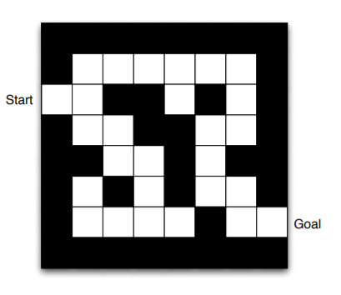
Concepts
Rewards
Policies
Value function
Q - Learning
Figure 2: Maze: Introduction
Notes:
Ask about what would be action and state. What all information does it need to do this task

Slide 12
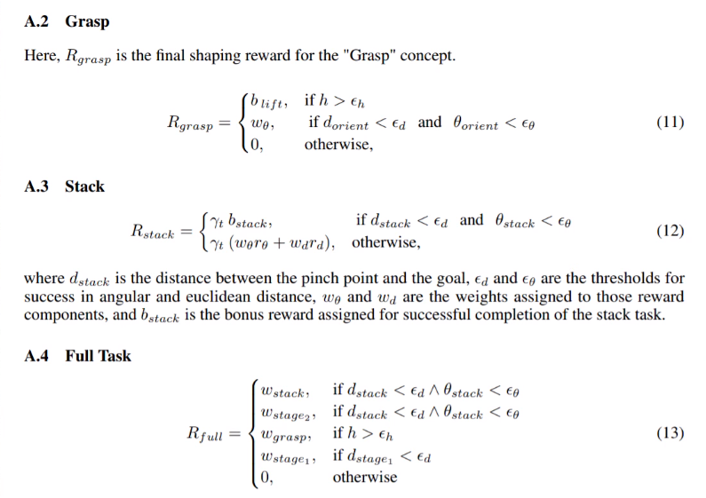
Reward
A reward is a scalar feedback signal, a dopamine for machines
Goal of RL: Maximize cumulative reward
Examples
Fly stunt manoeuvres in a helicopter
+ve reward for following desired trajectory
-ve reward for crashing
Climbing a hill
+ve reward for reaching a flag on top of hill
Manage an investment portfolio
+ve reward for each $ in bank
Play atari games better than humans
+/-ve reward for increasing/decreasing score
Figure 3: Reward function for grasping objects with robotic arm
David Silver, DeepMind: Intro to RL http://www0.cs.ucl.ac.uk/staff/d.silver/web/Teaching_files/intro_RL.pdf
Concept Network Reinforcement Learning for Flexible Dexterous Manipulation https://www.bons.ai/blog/robotics-blog
Notes:
Dopamine: relate to temporal difference learning in humans
Note different types of rewards. Difficult to create a custom reward function for each task. Difficult to create one for open ended tasks like AlphaGo as it would constrain policy to behaviour of humans

Slide 13


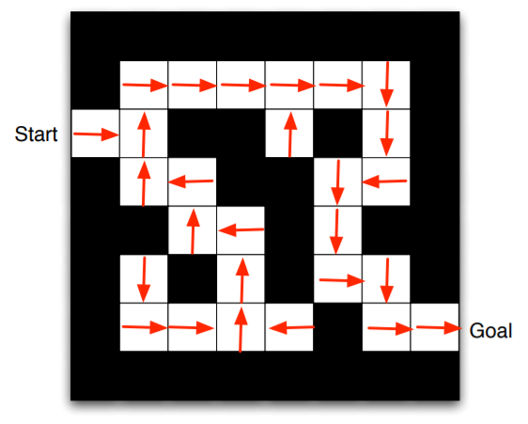
Policy
A policy is the agent’s behavior
Unique sequence of actions; map from state to action
Types:
Deterministic Policy
Stochastic Policy

Slide 14

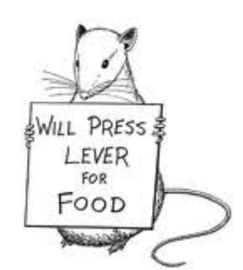
Value Function
David Silver, DeepMind: Intro to RLhttp://www0.cs.ucl.ac.uk/staff/d.silver/web/Teaching_files/intro_RL.pdf

Slide 15
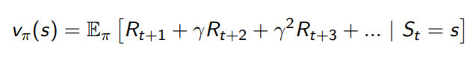
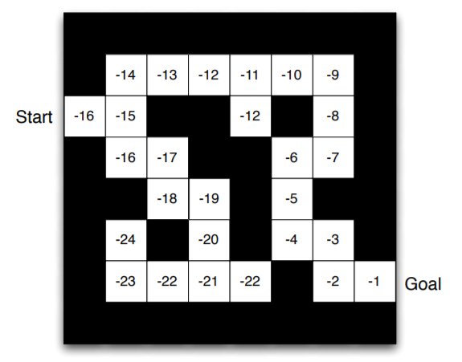
Value Function
Value function is a prediction of future reward
Used to evaluate the goodness/badness of states
To select between actions:

Slide 16

Q Learning
Quality of action in a given state
Must have a model, must know the states to which its actions will lead.
Chess program must know what it’s legal moves are and how they affect the board position.
A Q-learning agent
Learns a function, giving the expected quality of taking a given action in a given state.
Doesn’t need a model - Can compare the expected quality values for its available choices without needing to know their outcomes.
As they do not know where their actions lead, cannot perform look ahead, hence can seriously restrict their ability to learn.
Figure 4: Q function for a new state
Russell and Norvig: AIMA, 3rd Edition

Slide 17
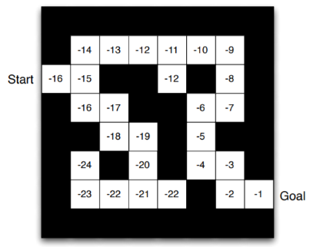
Quality Table
Quality of action in a given state
Q - Learning: choosing an action that has max(Q-value)
Q Table
State | N | S | E | W
Cell #1 | 0 | 0 | 0.5 | 0
Cell #2 | 0.8 | 0.5 | 0.1 | 0
….
Figure 4: Q function for a new state
Russell and Norvig: AIMA, 3rd Edition

Slide 18
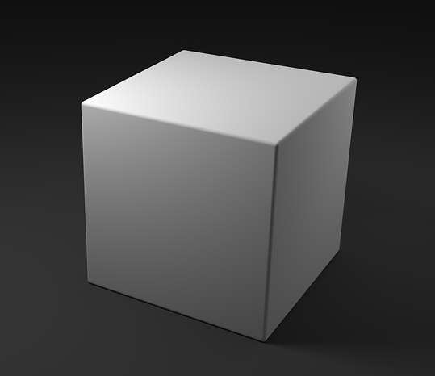
Demo: Mountain Car
action
position
Figure 5: Q table for Mountain Car program
velocity

Slide 19
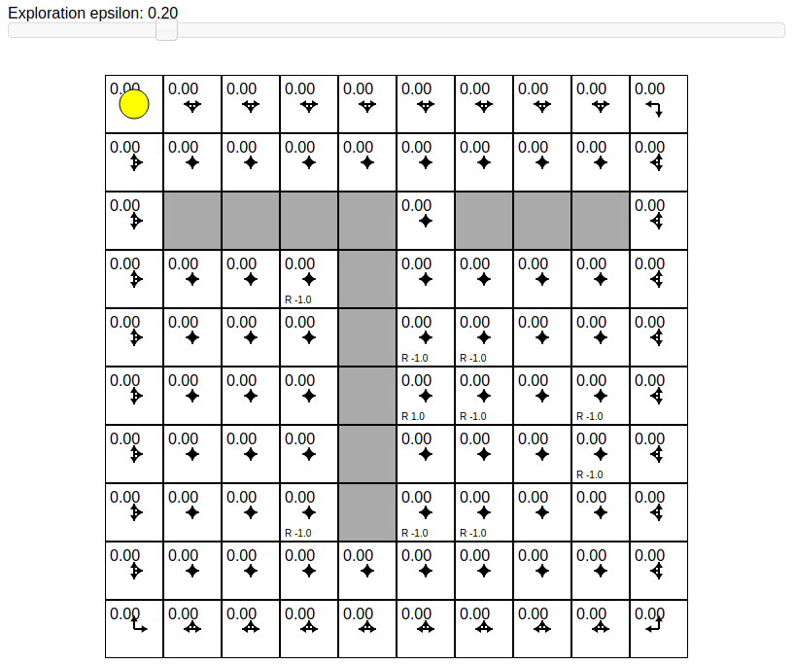
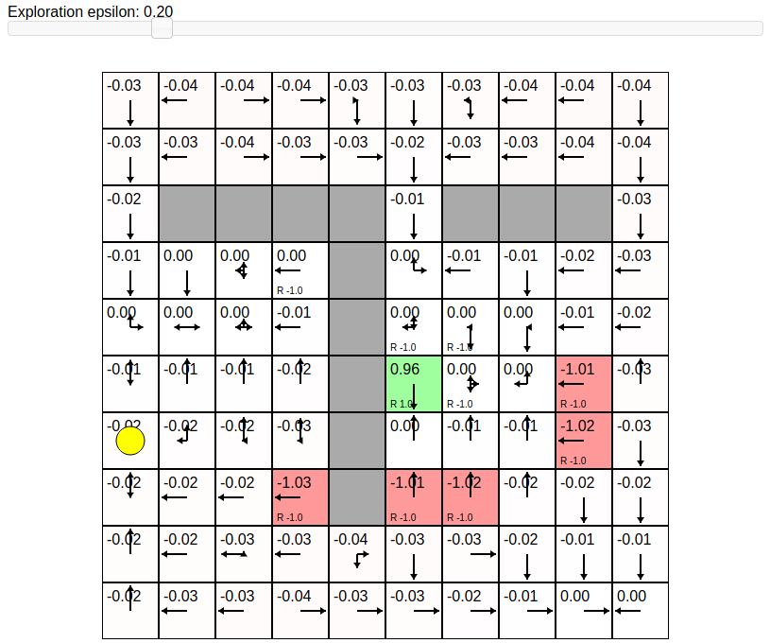
Demo: Q-Learning updates in a Grid
Notes:
python gridworld.py -a q -k 30 -e 0.9
Imagine a rich neighbour scenario.
State gets the value from its neighbour.

Slide 20
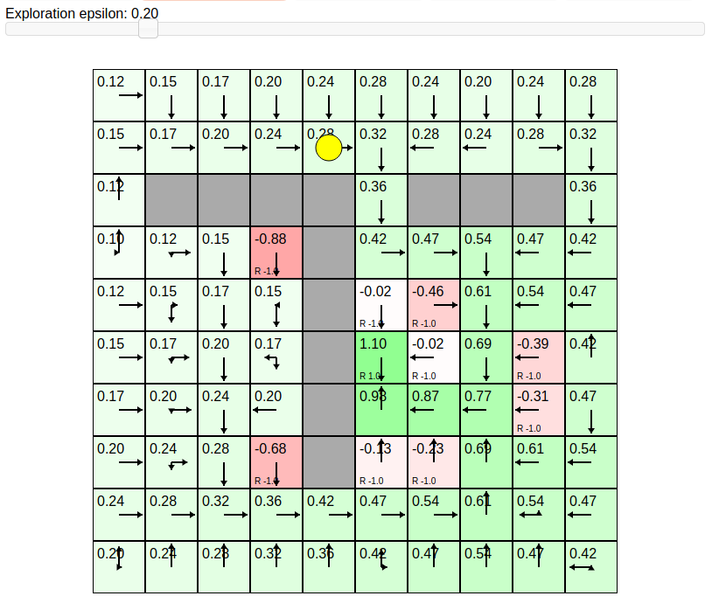
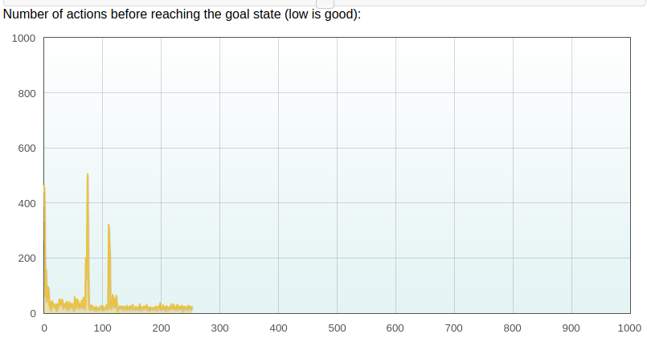
Q learning updates in a Grid
Number of Episodes
Notes:
After some time, agent realizes there is a path by which you can get high reward.

Slide 21
Exploration vs Exploitation
The agent should discover a good policy from its experiences of the environment without losing too much reward along the way
Exploration finds more information about the environment.
Exploitation exploits known information to maximise reward
Example: Restaurant selection
Exploitation: Go to your favourite restaurant
Exploration: Try a new restaurant
Є-greedy algorithm: With є probability, take random action
Exploration -> Take random action Exploitation -> Action with max Q value
David Silver Lectures on Reinforcement Learning, Prof. Subbarao Lecture slides on RL
Notes:
Reinforcement learning is like trial-and-error learning.
If state space has different paths to reach the goal, then the shorter one is prefered.
In the previous example, we had 2 options: explore, and exploitation

Slide 22
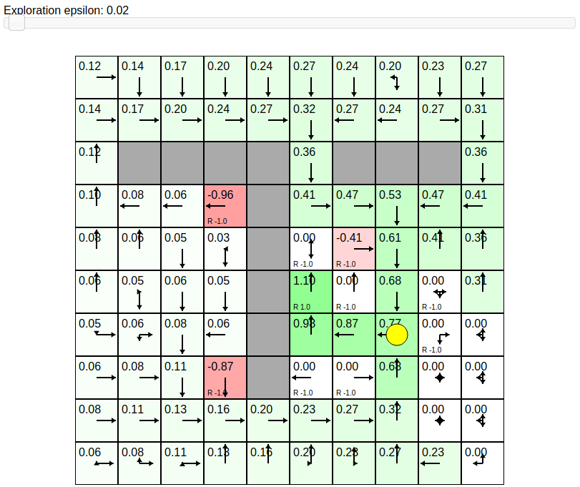
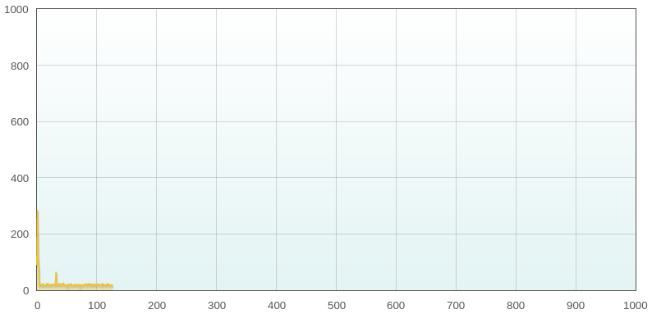
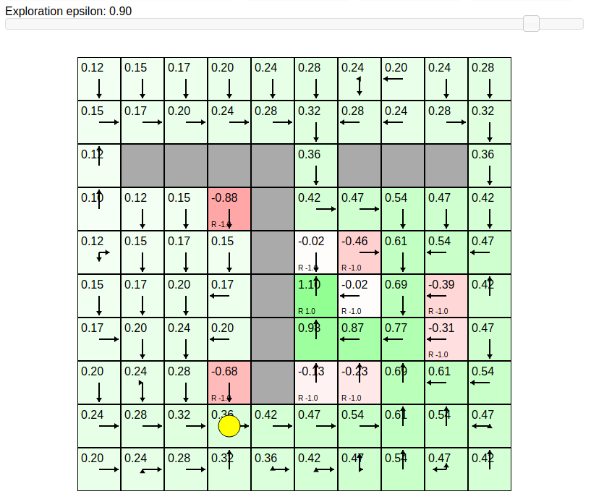
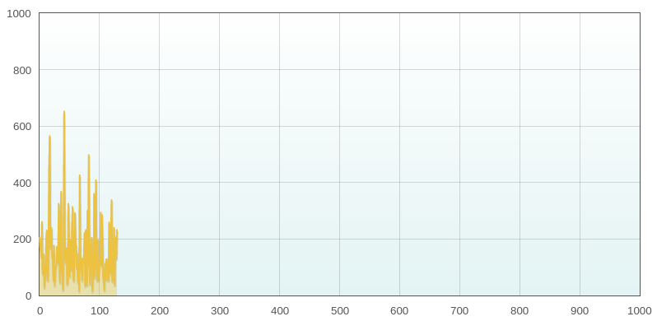
Epsilon = 0.02
Number of Actions taken to reach goal
Number of Episodes
Epsilon = 0.9
Number of Actions taken to reach goal
Number of Episodes

Slide 23
Exploration vs Exploitation
Why keep on doing random action after you have explored all the states ?
GLIE (Greedy in the limit of infinite exploration) scheme
Must try all state‐action combinations infinitely often; but must become greedy in the limit

Slide 24
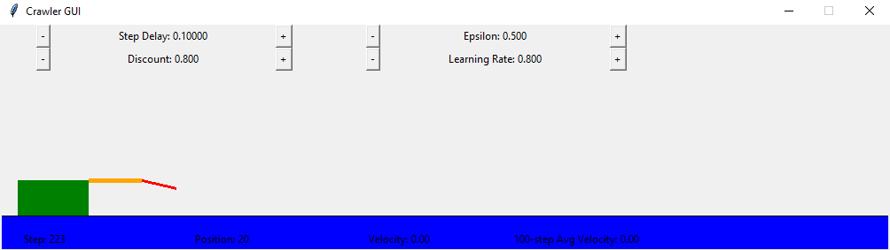
Demo: CRAWLER
Notes:
python crawler.py

Slide 25
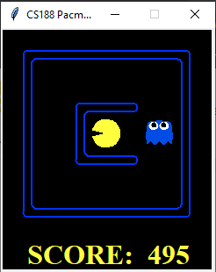
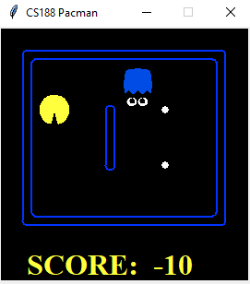
Demo: PAC-MAN with Q-Learning
Small Grid
Medium Grid
Notes:
python pacman.py -p PacmanQAgent -x 2000 -n 2010 -l smallGrid
python pacman.py -p PacmanQAgent -x 2000 -n 2010 -l mediumGrid
python pacman.py -p PacmanQAgent -x 2000 -n 2010 -l smallGrid -a epsilon=0.1,alpha=0.3,gamma=0.7

Slide 26
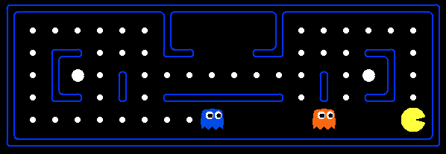
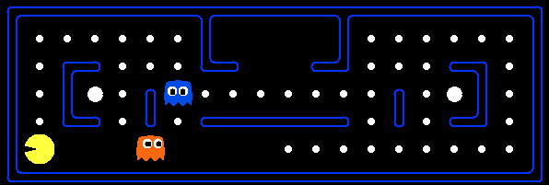
PAC-MAN with Q-Learning - Not sufficient Space?
Chess - state space size = 10^40
When problem has large state space, then Q table won't work.
Even if we had memory, never enough training data, takes too long
What to do now?

Slide 27
Factored representations to the rescue
Represent states in terms of features
Features are functions
Examples:
Distance from closest ghost
Distance from closest food
Number of ghosts k step away
Will agent eat a food pellet in the next step or not
Whether food will be eaten
How far away the next food is
Whether a ghost is one step away
Function approximation:
Key Idea: learn a value function as a linear combination of features.
https://www.cs.swarthmore.edu/~bryce/cs63/s16/slides/3-25_approximate_Q-learning.pdf
Prof. Subbarao, ASU, Lecture Slides on RL
Notes:
We can think of feature extraction as a change of basis.
Reduces the size of the Q-table.
States will share many features.
Allows generalization to unvisited states.
Makes behavior more robust: making similar decisions in similar states.
Handles continuous state spaces
Requires feature selection (often must be done by hand)
Restricts the accuracy of the learned rewards.
The true reward function may not be linear in the features
this is like performing gradient descent
Ex of features: no. of ghosts k step away, closest food, eats food or not, etc.

Slide 28
Demo: PAC-MAN with Approximate Q-Learning
Features used for this demo:
whether food will be eaten
how far away the next food is
whether a ghost is one step away
Notes:
python pacman.py -p PacmanQAgent -x 2000 -n 2010 -l mediumGrid
python pacman.py -p ApproximateQAgent -a extractor=SimpleExtractor -x 50 -n 60 -l mediumGrid
python pacman.py -p ApproximateQAgent -a extractor=SimpleExtractor -x 50 -n 60 -l mediumClassic
The compression achieved by a function approximator allows the learning agent to
generalize from states it has visited to states it has not visited. That is, the most important
aspect of function approximation is not that it requires less space, but that it allows for induc-
tive generalization over input states.

Slide 29
What’s new!
RL in Strategic Games
DOTA2 1-v-1 Gameplay
Robot solving Rubik’s Cube

Slide 30

RL in Strategic Games

Slide 31
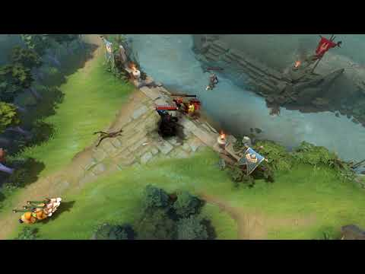
RL in DOTA2: Gameplay

Slide 32
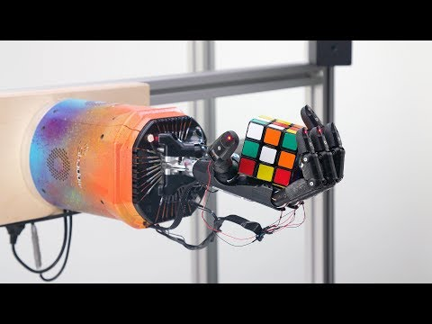
RL in Robotics: Solve Rubik’s Cube

Slide 33
References
Sham Kakade et al. https://rltheorybook.github.io/
CS188 - Intro to AI: http://ai.berkeley.edu/home.html
CSE471 - Intro to AI: https://www.dropbox.com/s/u2v9sdfmbe6pl7s/2019-cse471-week8.1.pdf?dl=0
UCL course on RL: http://www0.cs.ucl.ac.uk/staff/d.silver/web/Teaching.html
Sentdex’s Q-Learning project: https://pythonprogramming.net/q-learning-reinforcement-learning-python-tutorial/
Grid World Demo: https://cs.stanford.edu/people/karpathy/reinforcejs/gridworld_td.html
OpenAI Robot solving Rubik’s Cube: https://openai.com/blog/solving-rubiks-cube/
OpenAI Gym: https://gym.openai.com/envs/#classic_control

Slide 34


Thank you!
Notes:
Put LinkedIn Contact

Slide 35
Appendix
Markov Decision Process
Model based RL:
Approximate Dynamic Programming
Model free RL:
Monte Carlo Direct Estimation
Temporal Difference Learning
Active and Passive RL
On policy and Off policy RL:
Difference between SARSA and Q-Learning

